Slide 1
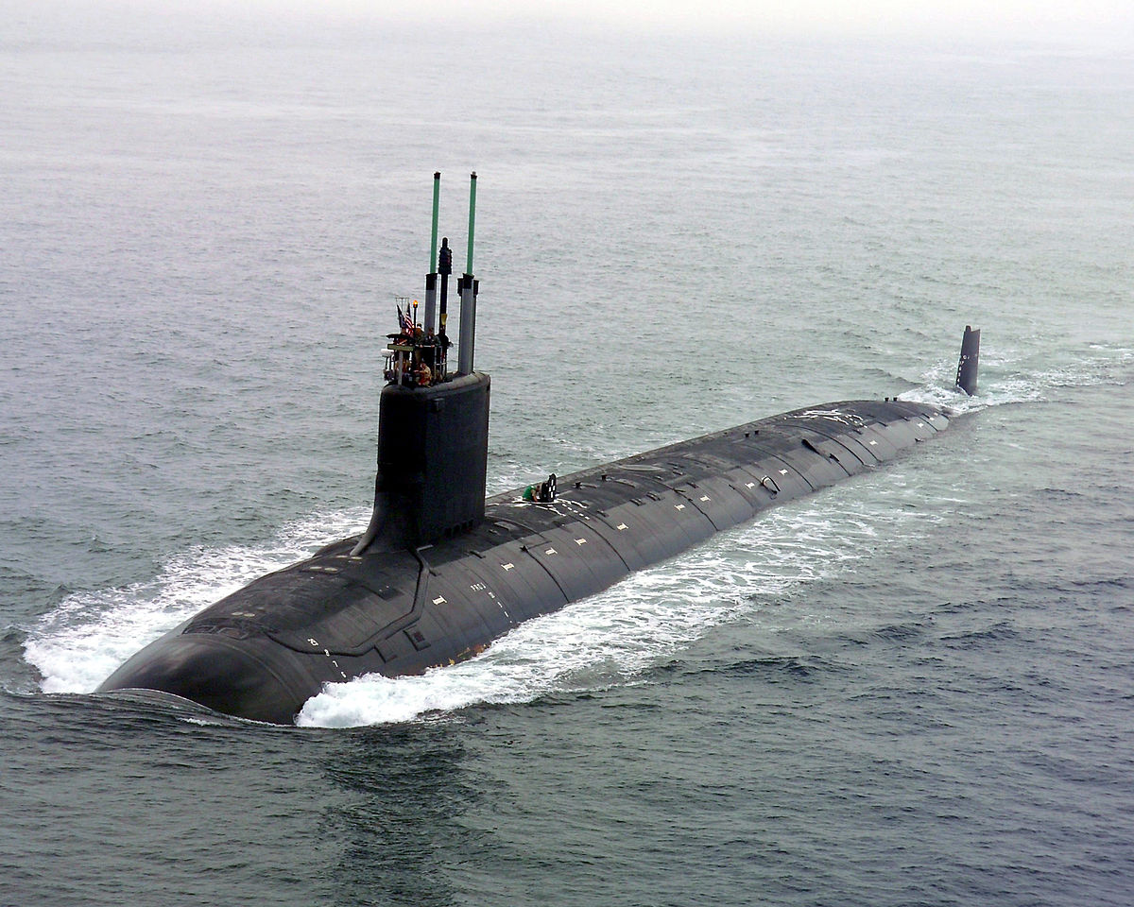
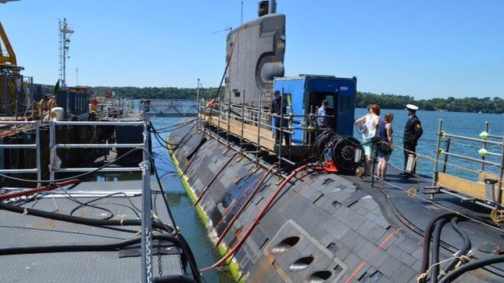
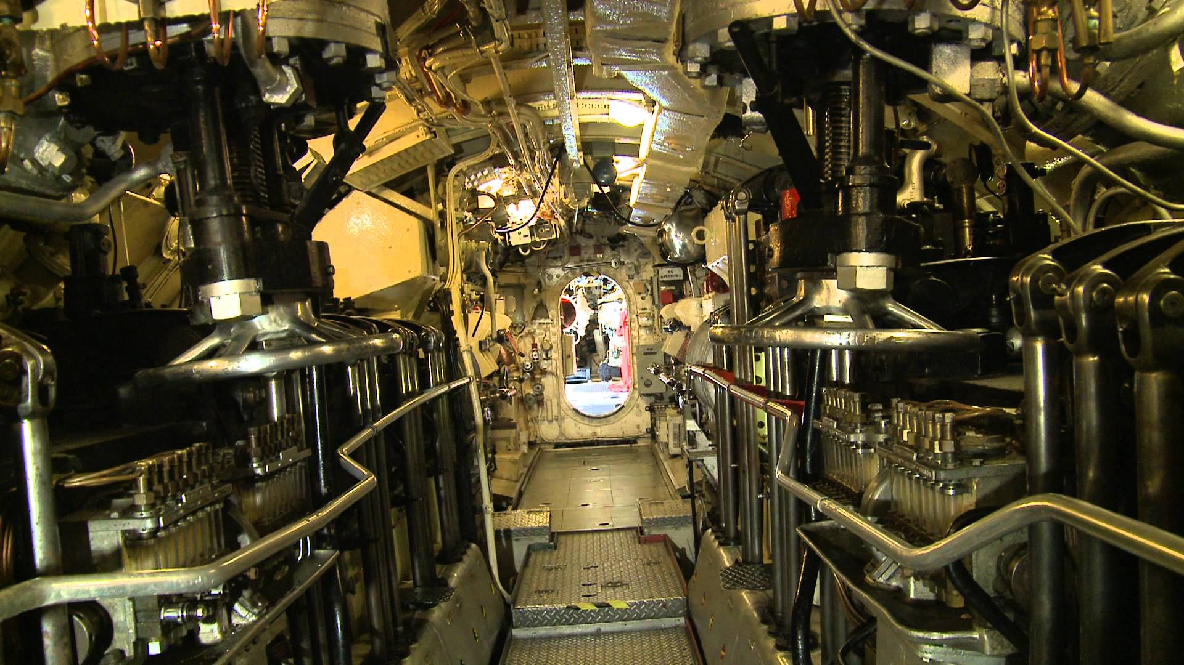
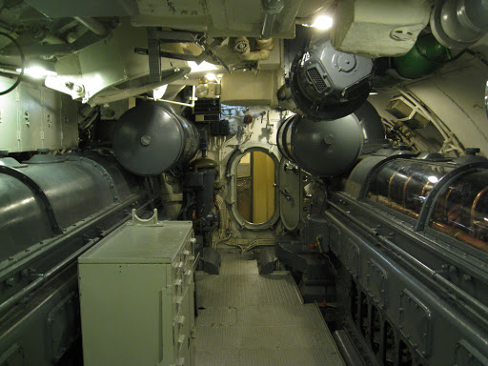
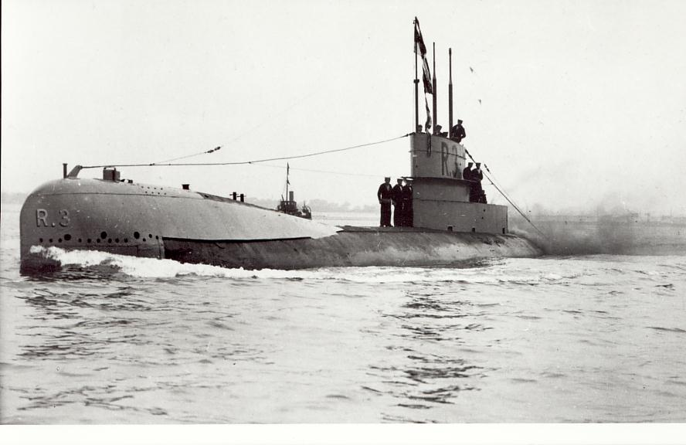
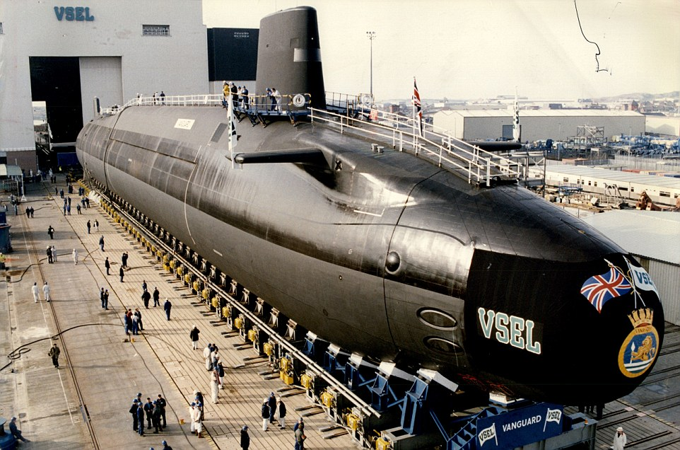
US Navy submarine in the ocean.
British Submarine at DevonPort.
Interior of submarine. Doorway is the oval shaped area down the narrow corridor.
Submarine during the first world war.
British Trident submarine worth 31 billion.
Another example of interior design in a Submarine.

